Slide 1
Overseas Buyers Step by Step Guide

Slide 2
All Buyers can register on the website

Slide 3
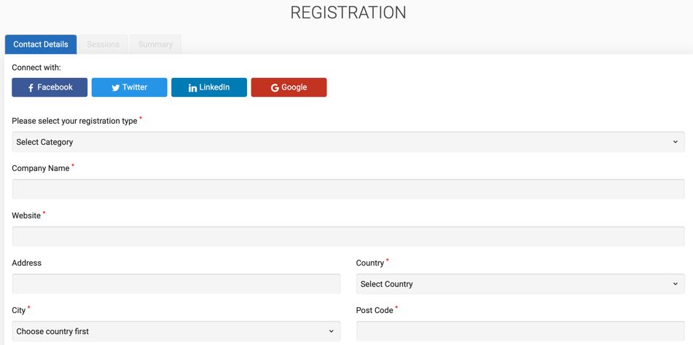
Registration is Easy

Slide 4
Post Registration EEPC INDIA will send an activation link on Buyer email

Slide 5
Once you click the confirmation mail link, you will be led inside the VIRTUAL SHOW

Slide 6
My profile: Your personal page to show all your activities

Slide 7
How to search Exhibitors: Option 1: You can visit FLOOR PLAN and see the all exhibitors

Slide 8
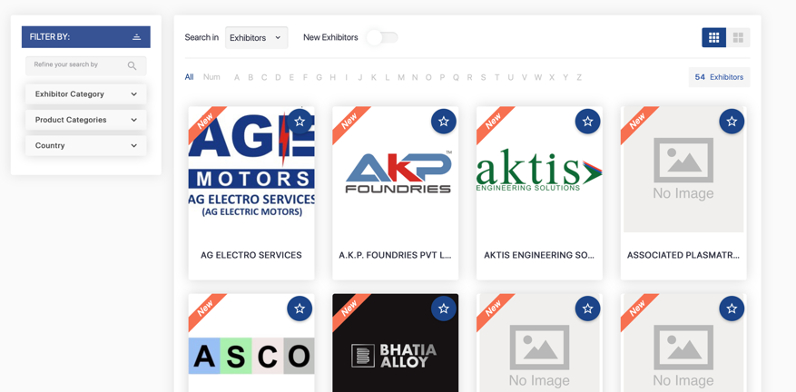
How to search Exhibitors: Option 2: You can visit EXHIBITORS & PRODUCTS and see the All exhibitors

Slide 9
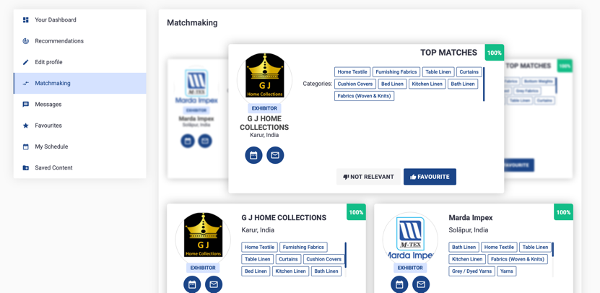
How to search Exhibitors: Option 3: You can also go to MY PROFILE and do MATCHMAKING

Slide 10
How to search Exhibitors: Option 4: you can also go to MY PROFILE and look for Recommendations

Slide 11
Business Discussions: If you want to discuss business with any company, you can Message or send a Meet request

Slide 12
Business Discussions: Click on Message and start chatting

Slide 13
Business Discussions: You can also send a Meet request

Slide 14
Business Discussions: Click on Meet and send a Meeting Request

Slide 15
Business Discussions: Click on Meet and send a Meeting Request. You can select Date / time / products for meeting

Slide 16
Business Discussions: All meetings will be shown in MY SCHEDULE and you will also get meeting requests from exhibitors. Please confirm / cancel / reschedule asap.

Slide 17
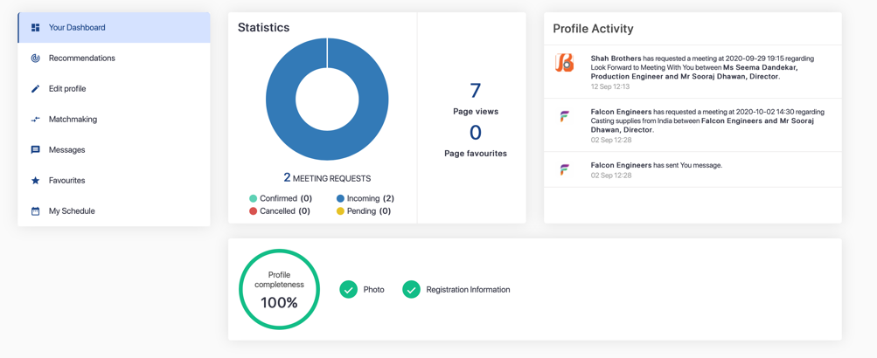
My profile: Regularly visit your personal page to see all your activities

Slide 18
Business Meetings: On Day of meetings, Join Rooms open 10 minutes before and you enter the meetings

Slide 19
You need to give permission to your Laptop to join

Slide 20
Switch on all your video / microphone and speaker before joining the room

Slide 21
Once you enter the meeting room, check if your speaker / camera / mike are on – GREEN state

Slide 22
You can text chat also video conference too

Slide 23
You can share screen and run presentations videos etc.

Slide 24
You can complete meetings by pressing RED link

Slide 25
Overseas Buyers Step by Step Guide

